Slide 1
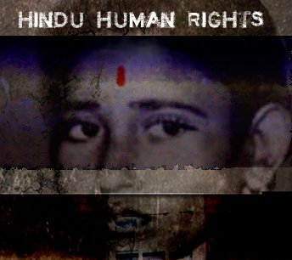
Bias and Prejudice Against Hindu Identity, Faith and/or Culture Survey
Thursday, November 11, 2021
HINDU HUMAN RIGHTS AUSTRALIA

Slide 2
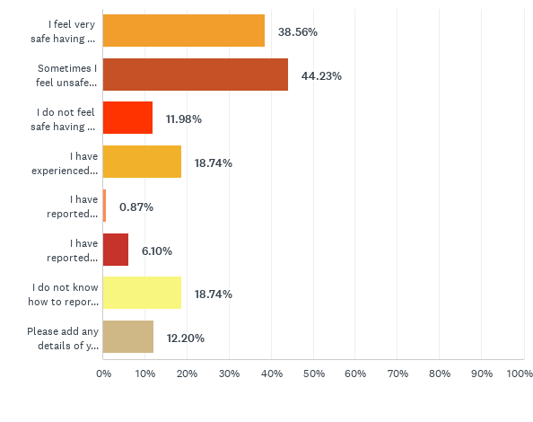
Q1: Where I live
I feel very safe having a Hindu identity, faith and/or culture where I live
Sometimes I feel unsafe having a Hindu identity, faith and/or culture where I live
I do not feel safe having a Hindu identity, faith and/or culture where I live
I have experienced abuse where I live for having a Hindu identity, faith and/or culture
I have reported Hinduphobia where I live and had my concerns addressed fairly
I have reported Hinduphobia where I live and not had my concerns addressed fairly
I do not know how to report HInduphobia where I live
Answered: 459 Skipped: 6

Slide 3
Q1: Where I live
“During my undergraduate programme, a class full of hindu students were made to laugh on “Gau Mata” jokes by a sociology female professor. Some of us tried resisting but were religion shamed and made to keep quite and get laughed on us.”
“Shamed for following my dharmic rituals ”
“A local temple has its direction signs taken away, so I have to navigate by the mile.”
“Afraid of showing Hindu identity as I will be wrongly labelled as a bigot or an extremist”
“Hindu symbols like the deities and Swastika are looked at as symbols of oppression and patriarchy.”
“We try to keep low profile. We never place traditional decorations outside the house even during festivals.” “I am in tears thinking that I thought I would not see these hate culture in my lifetime. 2 days back my father (61 yrs) was having conversation with some of his friends. His words were: "It’s going to be very difficult for our children to live in this world. The world is going backwards to dark days of history. "

Slide 4
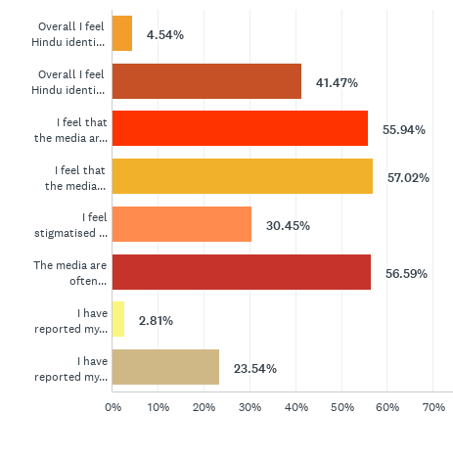
Q2: Media representations of Hindu identity, faith and/or culture
Overall I feel Hindu identity, faith and culture are fairly and accurately portrayed in the media
Overall I feel Hindu identity, faith and culture are NOT fairly and accurately portrayed in the media
I feel that the media are biased or prejudiced against Hindu identity, faith and/or culture
I feel that the media misrepresent and inaccurately portray Hindu identity, faith and/or culture
I feel stigmatised for my Hindu identity, faith and/or culture by the media
The media are often Hinduphobic
I have reported my concerns of Hinduphobia to the media and had them addressed fairly
I have reported my concerns of Hinduphobia to the media and NOT had them addressed fairly
Answered: 463 Skipped: 2

Slide 5
Q2: Media representations of Hindu identity, faith and/or culture
Answered: 463 Skipped: 2

Slide 6
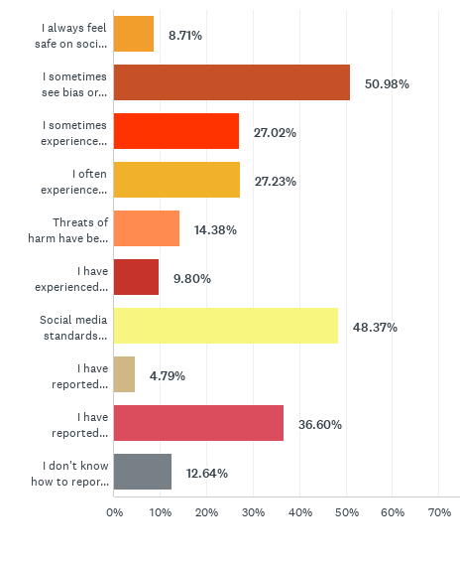
Q3: Social media
I always feel safe on social media with a Hindu identity, faith or culture
I sometimes see bias or prejudice against those on social media with Hindu identity, faith or culture
I sometimes experience abuse for on social media due to my Hindu identity, faith or culture
I often experience abuse and/or bullying due to my Hindu identity, faith or culture.
Threats of harm have been directed at me on social media due to my Hindu identity, faith or culture.
I have experienced stalking, doxxing, rape or death threats on social media due to my Hindu identity, faith or culture.
Social media standards enable Hinduphobia
I have reported Hinduphobia on social media and had my concerns dealt with effectively
I have reported Hinduphobia on social media and my concerns have been ignored
I don't know how to report Hinduphobia on social media
Answered: 459 Skipped: 6

Slide 7
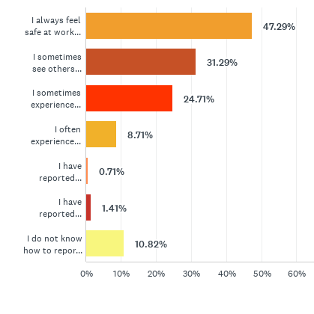
Q4: At work
I always feel safe at work to hold a Hindu identity, faith or culture
I sometimes see others experience prejudice or bias at work for their Hindu identity, faith or culture
I sometimes experience prejudice or bias at work due to my Hindu identity, faith or culture
I often experience prejudice or bias at work due to my Hindu identity, faith or culture
I have reported Hinduphobia at work and had my concerns fairly addressed
I have reported Hinduphobia at work and my concerns have not been fairly addressed
I have reported my concerns of Hinduphobia to the media and had them addressed fairly
I do not know how to report Hinduphobia at work
Answered: 425 Skipped: 40

Slide 8
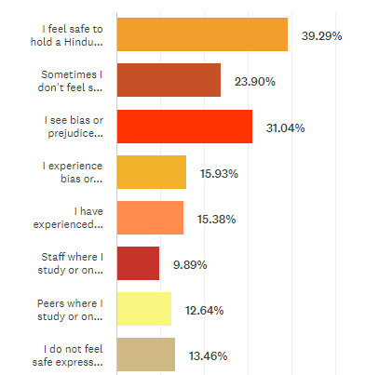
Q5: Education -- Online and/or On Campus
I feel safe to hold a Hindu identity, faith or culture where I study either online or on campus
Sometimes I don't feel safe to hold a Hindu identity, faith or culture where I study either online or on campus
I see bias or prejudice against Hindu identity, faith and/or culture where I study either online or on campus
I experience bias or prejudice against Hindu identity, faith and/or culture where I study either online or on campus
I have experienced direct bias or prejudice against me for my Hindu identity, faith and/or culture where I study either online or on campus
Staff where I study or on campus have been biased or prejudiced against me due to my Hindu identity, faith or culture
Peers where I study or on campus have been biased or prejudiced against me due to my Hindu identity, faith or culture
I do not feel safe expressing myself in my studies due to bias or prejudice against Hindu identity, faith or culture
Answered: 364 Skipped: 101

Slide 9
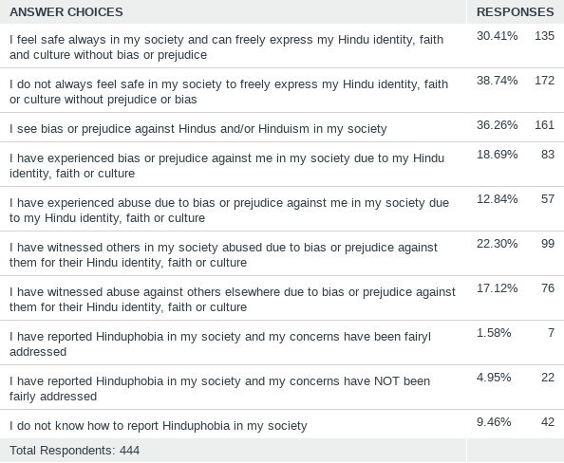
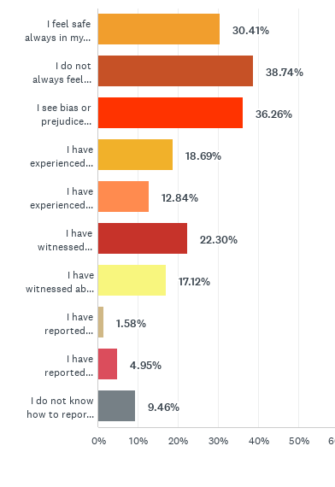
Q6: Society
Answered: 444 Skipped: 21

Slide 10
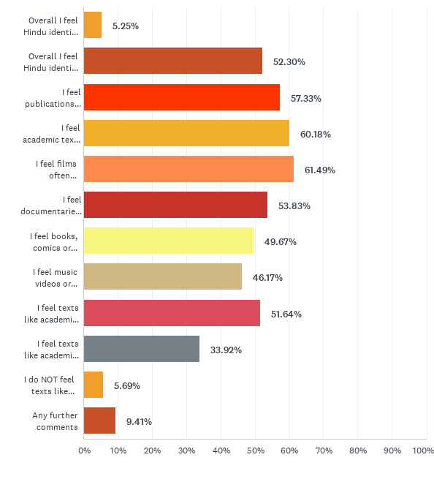
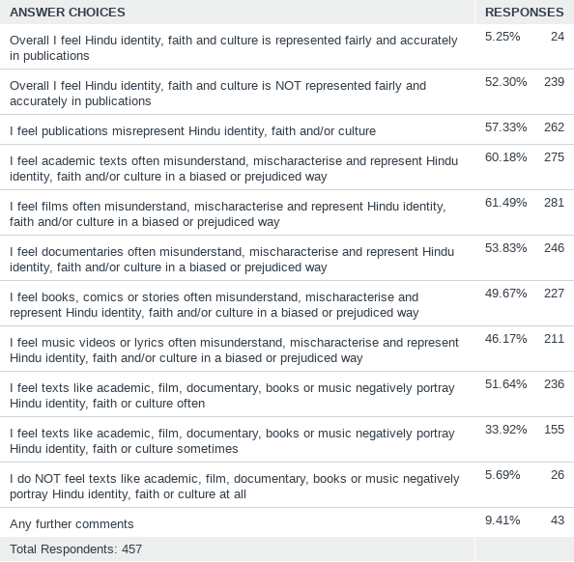
Q7: Publications: Books, Films, Documentaries, Culture
Answered: 457 Skipped: 8

Slide 11
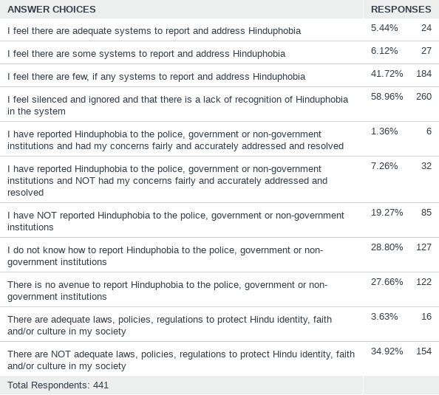
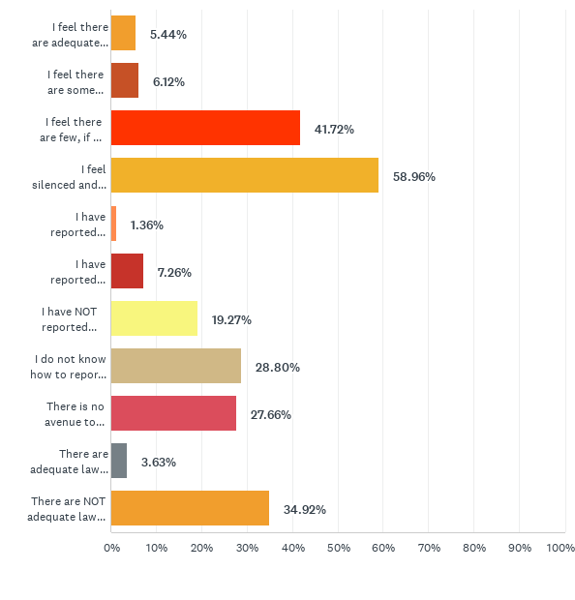
Q8: Responses to Hinduphobia Systemic and Institutional
Answered: 441 Skipped: 24

Slide 12
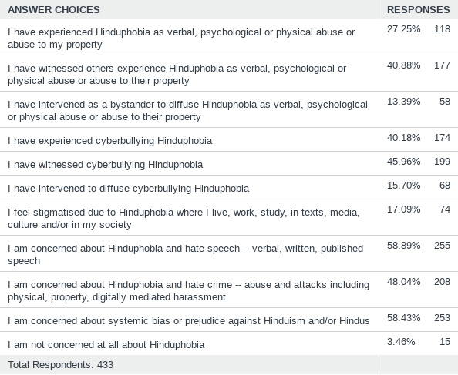
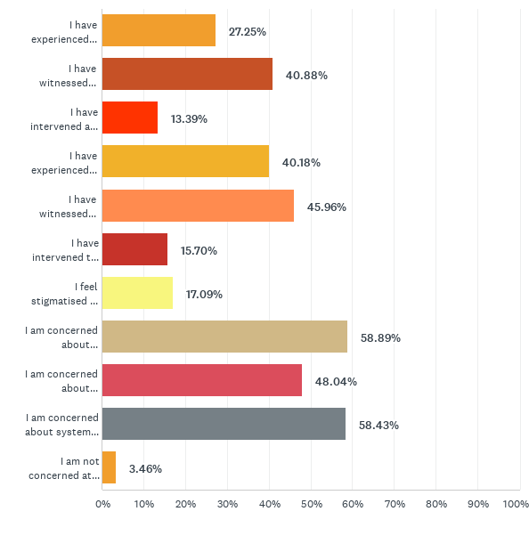
Q9: Forms of Hinduphobia
Answered: 433 Skipped: 32

Slide 13
HINDU HUMAN RIGHTS.COM.AU

